Slide 1
API Bounded Context
Domain Driven Design introduces artifacts to model the domain - but a large domain must be split into sub domains called “bounded context” How do we start?
March 2020

Slide 2
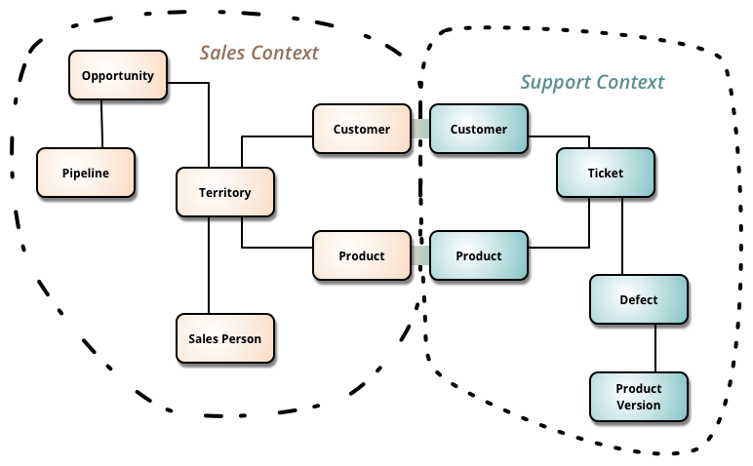
Bounded Context
Note the interrelated “entities” in each sub domain
“Bounded Context is a central pattern in Domain-Driven Design. It is the focus of DDD's strategic design section which is all about dealing with large models and teams. DDD deals with large models by dividing them into different Bounded Contexts and being explicit about their interrelationships.” – Martin Fowler
This is not “Canonical” each context keeps sometimes the same data but treats it differently

Slide 3
Discussion
Value Stream
Product Development and Credit Analytics
Sales and Marketing
Contract Booking
Customer Service
Collections
Loss Recovery and Remarketing
Systems
Marketing Web and Mobile
Auto Loan Application
Servicing Application
CRM Application
Collections Application
Remarketing Application
Party
Consumer Auto Finance Domain
Consumer
Prospect
Applicant
Customer
Preferences
Dealership
Offering
Vehicle
Span of Information
Subject Areas
Product
Title
Incentive
Entitlement
Agreement
Application
Servicing Account
Contract
Payment
Case
Claim

Slide 4
Discussion
Product Development and Credit Analytics
Sales and Marketing
Contract Booking
Customer Service
Collections
Loss Recovery and Remarketing
Marketing Web and Mobile
Auto Loan Application
Servicing Application
CRM Application
Collections Application
Remarketing Application
Consumer Marketing
Application and Sales
Customer
Servicing
Vehicle Remarketing
Party
Consumer
Prospect
Applicant
Customer
Bounded Context
Preferences
Dealership
Offering
Sub Domains
Vehicle
Product
Title
Incentive
Entitlement
Agreement
Application
Servicing Account
Contract
Payment
Case
Claim

Slide 5
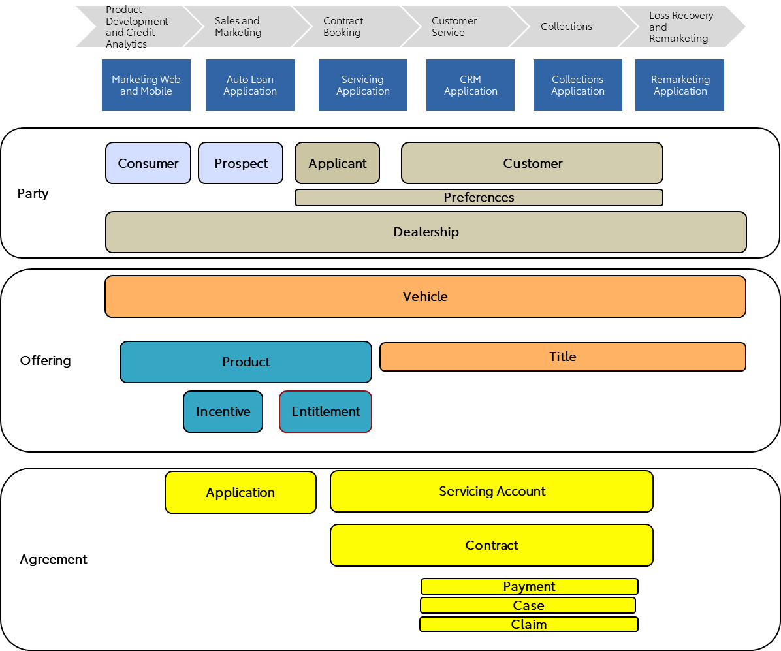
Discussion
Bounded Context
Consumer Marketing
Application and Sales
Customer
Servicing
Vehicle Remarketing
Preferences
Preferences
Preferences
Dealership
Dealership
Dealership
Auction
Consumer
Prospect
Applicant
Customer
Case
Vehicle
Vehicle
Vehicle
Application
Contract
Servicing Account
Title
Vehicle
Valuation
Payment
Incentive
Incentive
Title
Proceeds

Slide 6
Bounded Context
Discussion
Application and Sales
Preferences
Vehicle Remarketing
Dealership
Payment Received
Web Click ?
Applicant
Address Changed
Due Date Changed
Dealership
Auction
Vehicle
Application
Consumer Marketing
Customer
Servicing
Vehicle
Preferences
Incentive
Preferences
Title
Dealership
Valuation
Consumer
Prospect
Customer
Application Submitted
Case
Proceeds
Vehicle
New Booking
Contract
Servicing Account
Vehicle Sold
New Customer
Vehicle
Payment
Incentive
Title

